Slide 1
IT 418/518: Foundations of Data Science
Class 9
Dr. Rajeev Bukralia

Slide 2
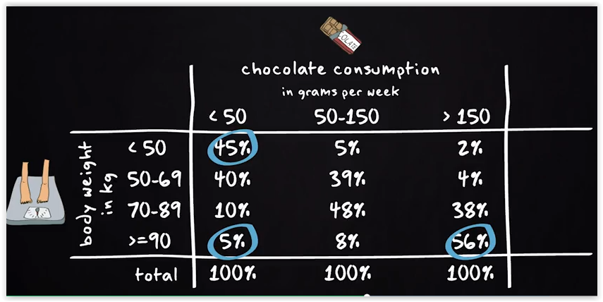
Does eating a lot of chocolate increase your body weight?
Suppose height of every individual in the sample is the same.

Slide 3
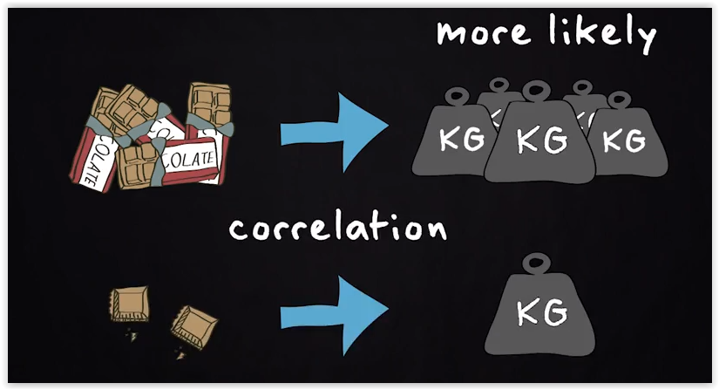
Correlation

Slide 4

Correlation

Slide 5
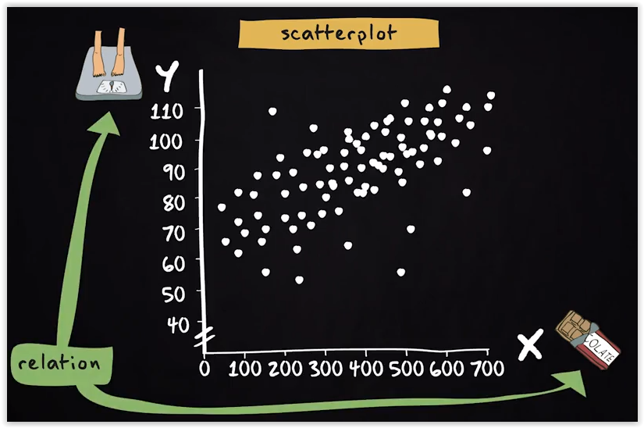
Correlation
The scatterplot shows at a glance that there is a strong correlation between the two variables. The more chocolate someone eats, the larger the body weight. But how strong is this correlation?

Slide 6
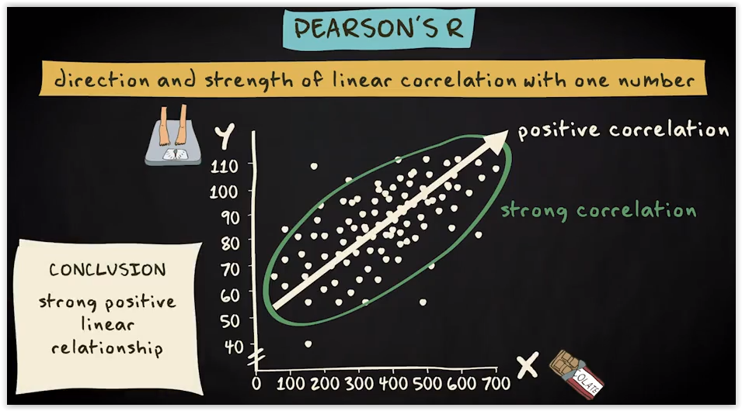
Correlation Relationship

Slide 7
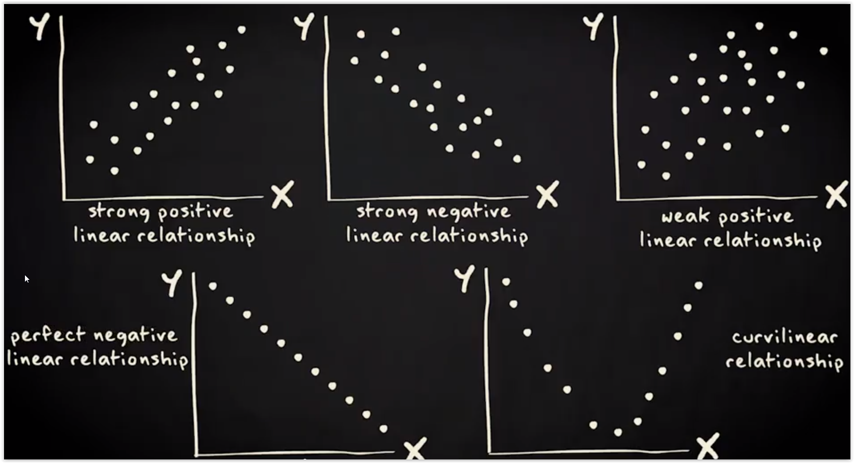

Slide 8
Pearson’s r
A scatterplot helps us to broadly assess whether a correlation is strong or weak and the direction (positive or negative). But it does not tell us exactly how strong the relationship is. Pearson's r is a measure that can show us exactly that.
The Pearson's r (correlation coefficient) tells us the direction and exact strength of the linear relationship between two quantitative variables.
A positive Pearson's r indicates that a correlation is positive, and a negative correlation indicates that it is negative.
Pearson's r is always a number between -1 and 1. Minus one refers to a perfect negative correlation, and plus one to a perfect positive correlation. And zero means that there is no correlation at all.

Slide 9
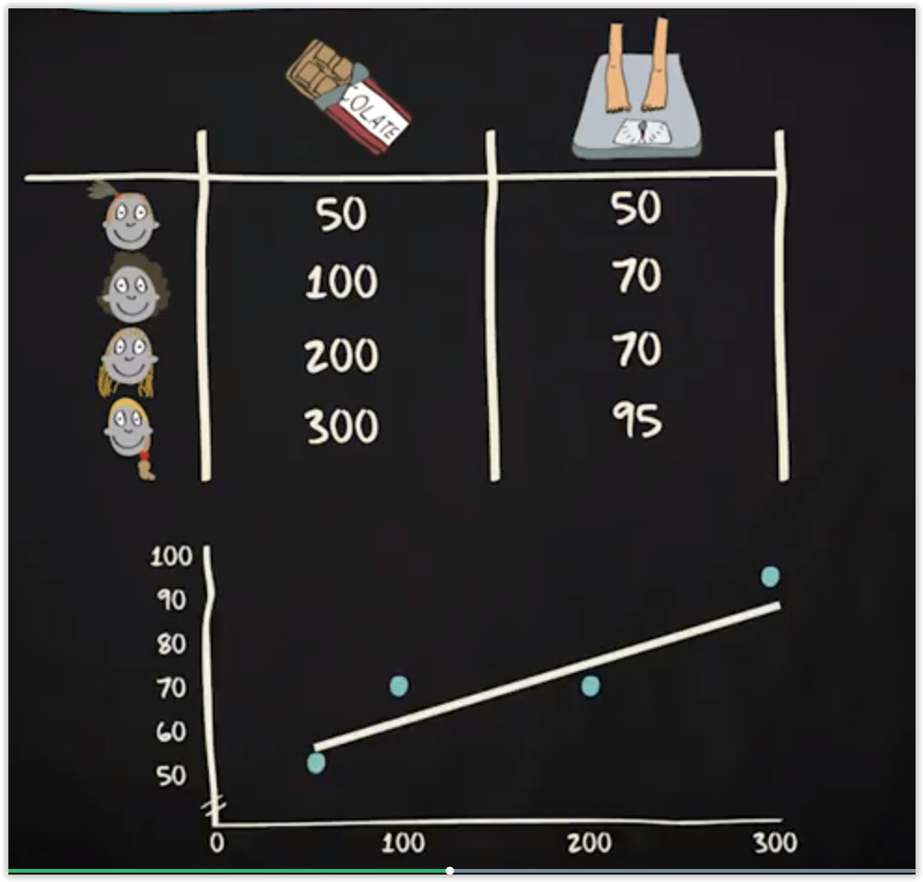
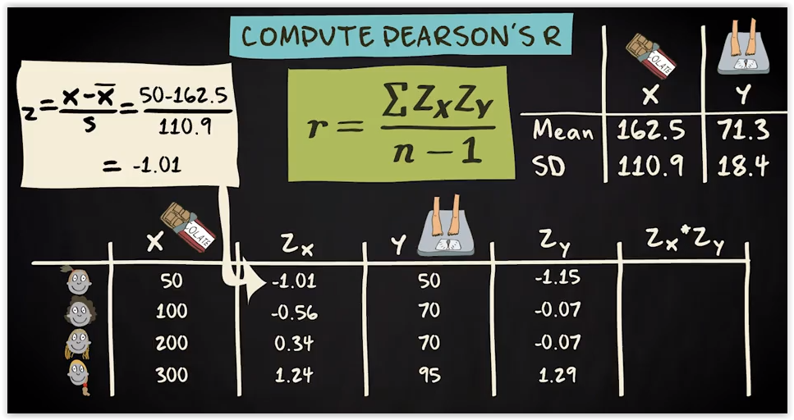
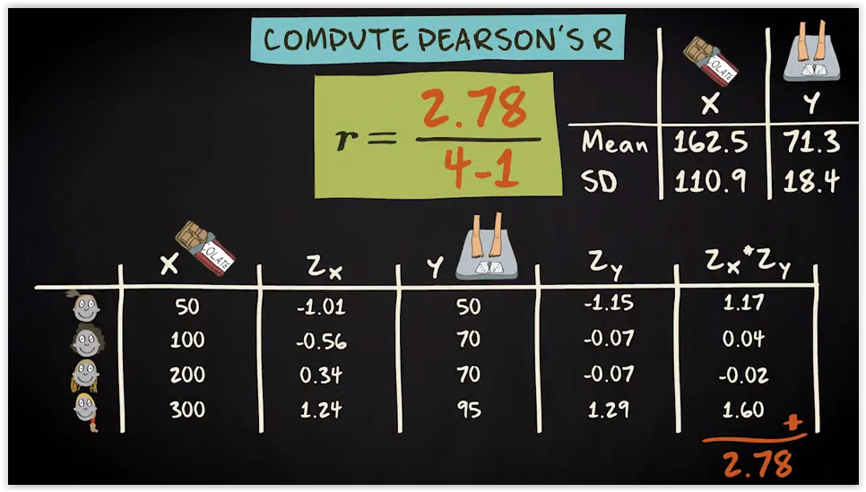
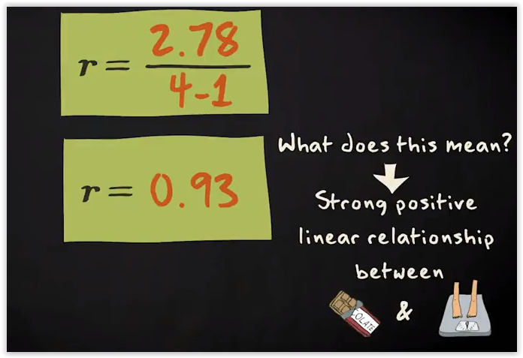
Compute Pearson’s r

Slide 10
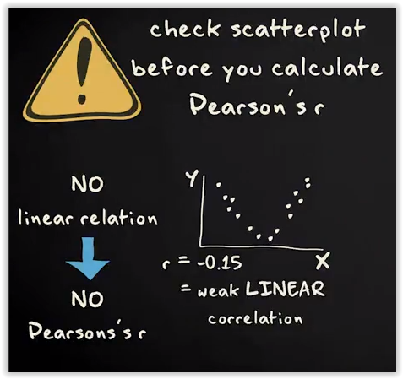
Pearson’s r
You can always compute a Pearson's r, even if the relationship is not linear. Therefore, it is very important that before you compute a Pearson's r, you can always check the scatterplot first to see if your variables are linearly related.
If not, do not compute a Pearson's r, because it doesn't tell you much about relationship between your variables.
This scatterplot, for instance, shows that there's a strong curvilinear relationship between x and y. If you compute the Pearson's r you will get a very low value, -0.15. This doesn't tell you that there is a weak correlation, it only tells you that there is a weak linear correlation.

Slide 11
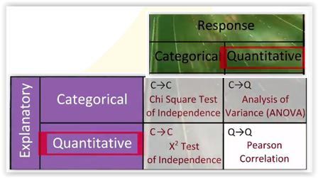
Question
What statistical procedure would most likely be used to answer the following research question:
Does knowing a college student's ACT score tell us anything about his or her first year college grade point average?
Pearson’s r
Chi Square test of independence
ANOVA
Answer: Pearson’s r

Slide 12
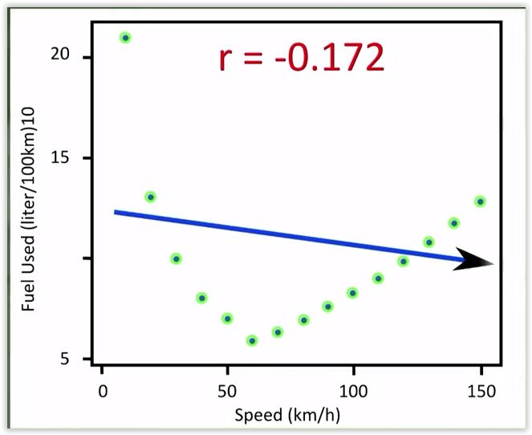
Question
Consider the relationship between the average fuel usage driving a fixed distance in a car and the speed at which the car drives. What are your observations?

Slide 13
Question
Consider the relationship between the average fuel usage driving a fixed distance in a car and the speed at which the car drives. What are your observations?
Answer: The data describes a fairly simple curvilinear relationship. The amount of fuel consumed decreases rapidly to a minimum, for a car driving 60 kilometers per hour. And then increases gradually for speeds exceeding 60 kilometers per hour.
The correlation r is equal to -0.172. It indicates a weak linear relationship. This makes sense considering the data fails to adhere closely to a linear form.

Slide 14
Pearson Correlation in Python
Pandas offers corr() function
NumPy’s corrcoef()
SciPy’s stats module

Slide 15
Sample Code in Python for Pearson’s r
import pandas
import numpy
import seaborn
import scipy
import matplotlib.pyplot as plt
#load your data
data = pandas.read_csv('gapminder.csv', low_memory=False)
#setting variables you will be working with to numeric
data['internetuserate'] = data['internetuserate'].convert_objects(convert_numeric=True)
scat1 = seaborn.regplot(x="urbanrate", y="internetuserate", fit_reg=True, data=data)
plt.xlabel('Urban Rate')
plt.ylabel('Internet Use Rate')
plt.title('Scatterplot for the Association Between Urban Rate and Internet Use Rate')
data_clean=data.dropna()
print ('association between urbanrate and internetuserate')
print (scipy.stats.pearsonr(data_clean['urbanrate'], data_clean['internetuserate']))

Slide 16
Spearman Correlation
Pearson correlation assumes that the data is normally distributed and linear.
Spearman correlation does not assume that data is from a specific distribution, so it is a non-parametric correlation measure.
You can use the corr() function with parameter method=”spearman” to compute spearman correlation using Pandas.

Slide 17
Visual Analytics

Slide 18
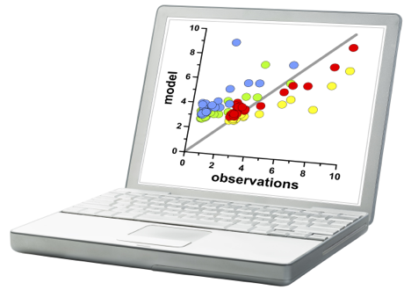
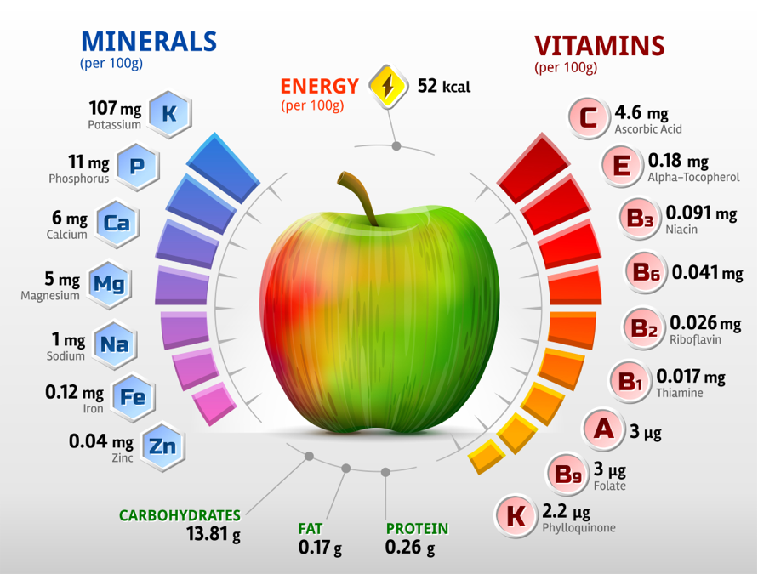
Exploratory data analysis: aka visual analytics
Presenting results: communicating and engaging people with data

Slide 19
Best Practices
Ask the right questions
Choose the right chart
Keep it simple
Use consistent colors and typography

Slide 20
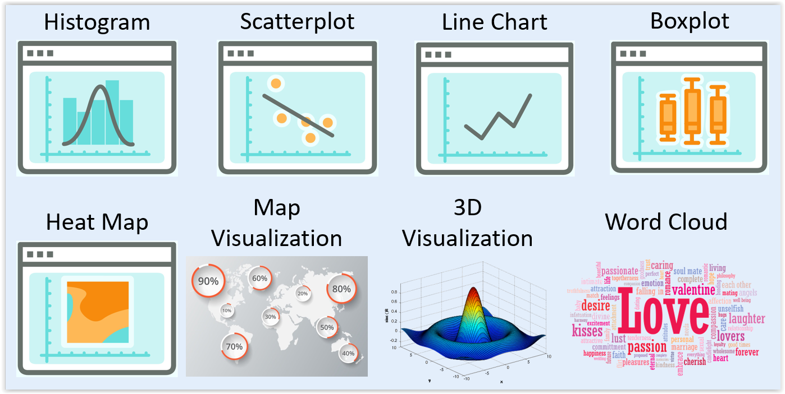
Visualizations

Slide 21
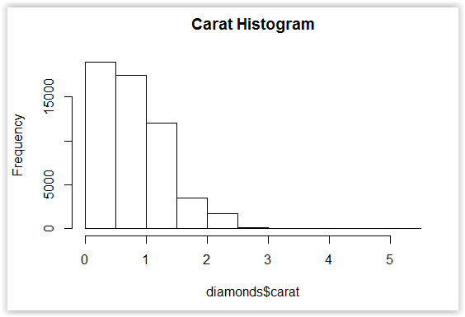
Histograms
A bar chart is a histogram for discrete data. It records frequency of every value of a categorical variable.

Slide 22
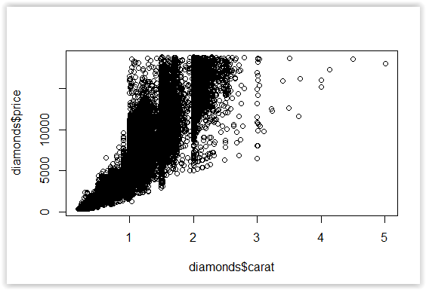
Scatterplots
Show two variables in comparison to each other

Slide 23
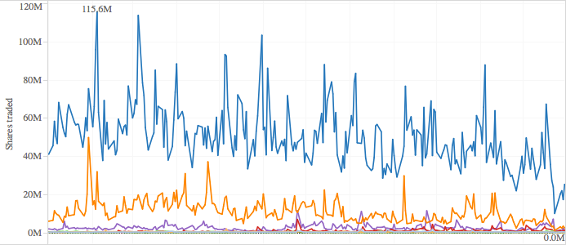
Line Charts
Source: Tableau, Tech Equity in 2009 Recession

Slide 24
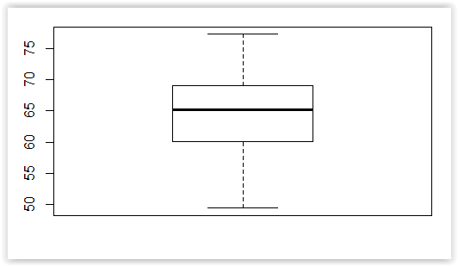
Boxplots
Effective for comparing groups, finding outliers

Slide 25
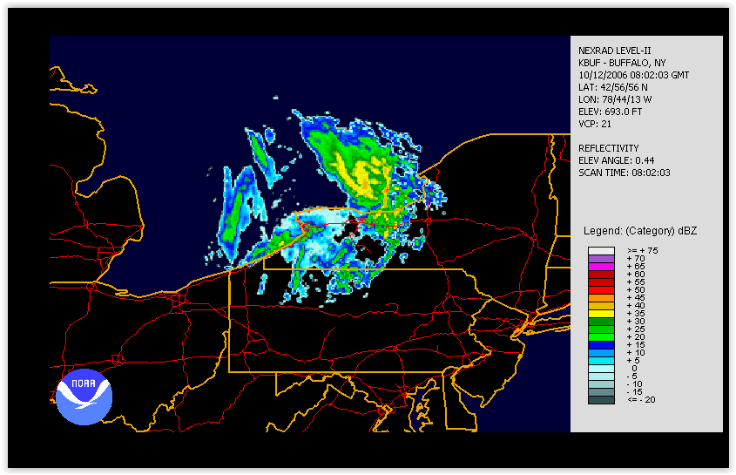
Heat Maps
Source: noaa.gov

Slide 26
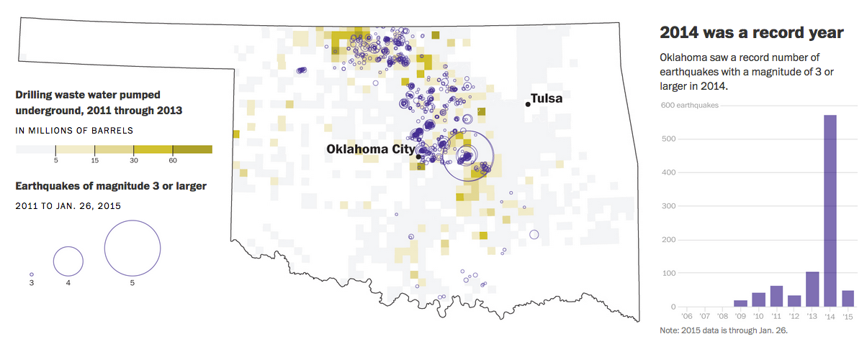
Map Visualizations
Source: Dan Keating and Darla Cameron. Damaging quakes in Oklahoma. Jan 28 2015. Washington Post

Slide 27
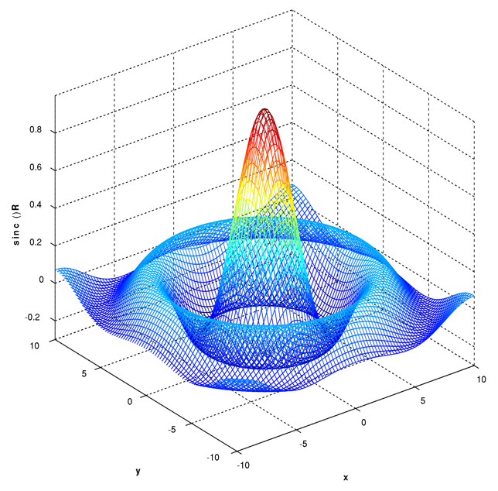
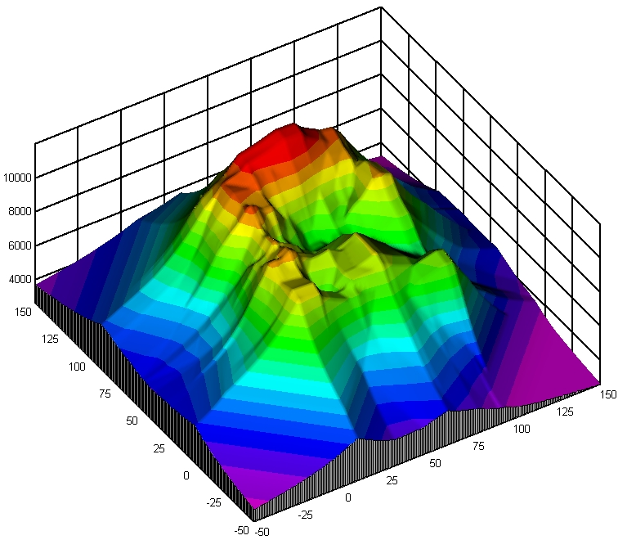
3D Visualizations

Slide 28
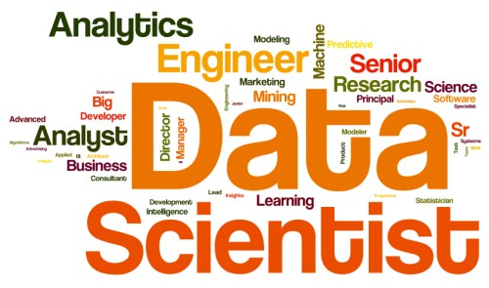
Word Clouds
Source: Gregory Piatesky. Most Demanded Data Science and Data Mining Skills. December 15 2014. kdnuggets.com

Slide 29
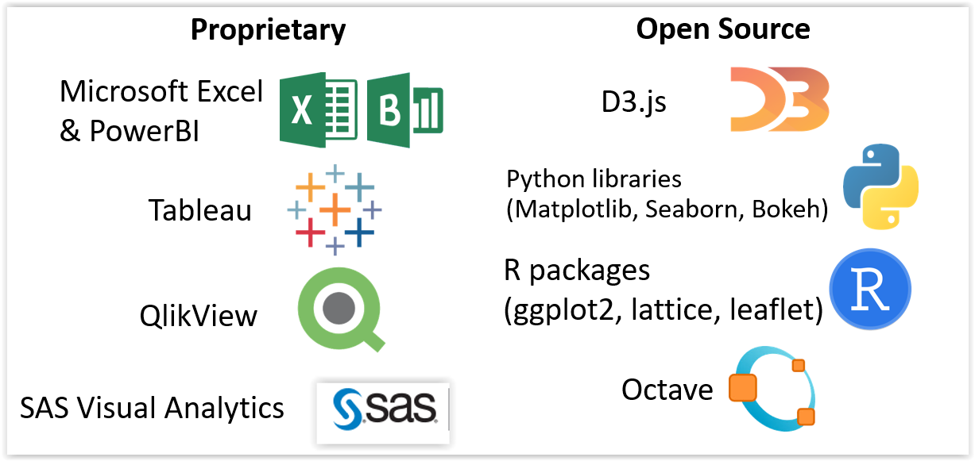
Data Visualization Software

Slide 30


Visualization Resources
Reddit: Data is Beautiful
Tableau Visual Gallery

